Slide 1
Demultiplexer
This presentation will demonstrate
The basic function of the Demultiplexer (DEMUX).
The typical application of a DEMUX.
Notes:
Introductory Slide / Overview of Presentation
Multiplexers & Demultiplexers
Digital Electronics™
Lesson 2.4 – Specific Combo Circuits & Misc Topics
Project Lead The Way, Inc.
Copyright 2009

Slide 2
What is a Multiplexer (MUX)?
A MUX is a digital switch that has multiple inputs (sources) and a single output (destination).
The select lines determine which input is connected to the output.
MUX Types
  → 2-to-1 (1 select line)
  → 4-to-1 (2 select lines)
  → 8-to-1 (3 select lines)
  → 16-to-1 (4 select lines)
Multiplexer
Block Diagram
2^{N}
1
Inputs
(sources)
MUX
Output
(destination)
N
Select
Lines
Notes:
Multiplexers & Demultiplexers
Digital Electronics™
Lesson 2.4 – Specific Combo Circuits & Misc Topics
Project Lead The Way, Inc.
Copyright 2009

Slide 3
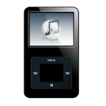
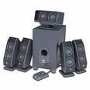


Typical Application of a MUX
Multiple Sources
Selector
Single Destination
MP3 Player
Docking Station
D0
D1
D2
D3
Laptop
Sound Card
MUX
Y
Surround Sound System
Digital
Satellite
B | A | Selected Source
0 | 0 | MP3
0 | 1 | Laptop
1 | 0 | Satellite
1 | 1 | Cable TV
Digital
Cable TV
Notes:
This slide shows a typical application of a multiplexer (in this case a 4-to-1 MUX). Have the students share other common applications of MUXs.
http://images.tigerdirect.ca/skuimages/large/Logitech-X-540-L23-7250-mai.jpg
Multiplexers & Demultiplexers
Digital Electronics™
Lesson 2.4 – Specific Combo Circuits & Misc Topics
Project Lead The Way, Inc.
Copyright 2009

Slide 4
Demultiplexer : DEMUX
It reverses the multiplexing function.
It takes data from one line and distributes them to a given number of output lines. It is also known as a data distributor.
A demultiplexer takes a single input and distributes it over several outputs.
Compares to MUX : A multiplexer takes several inputs and transmits one of them to the output.

Slide 5
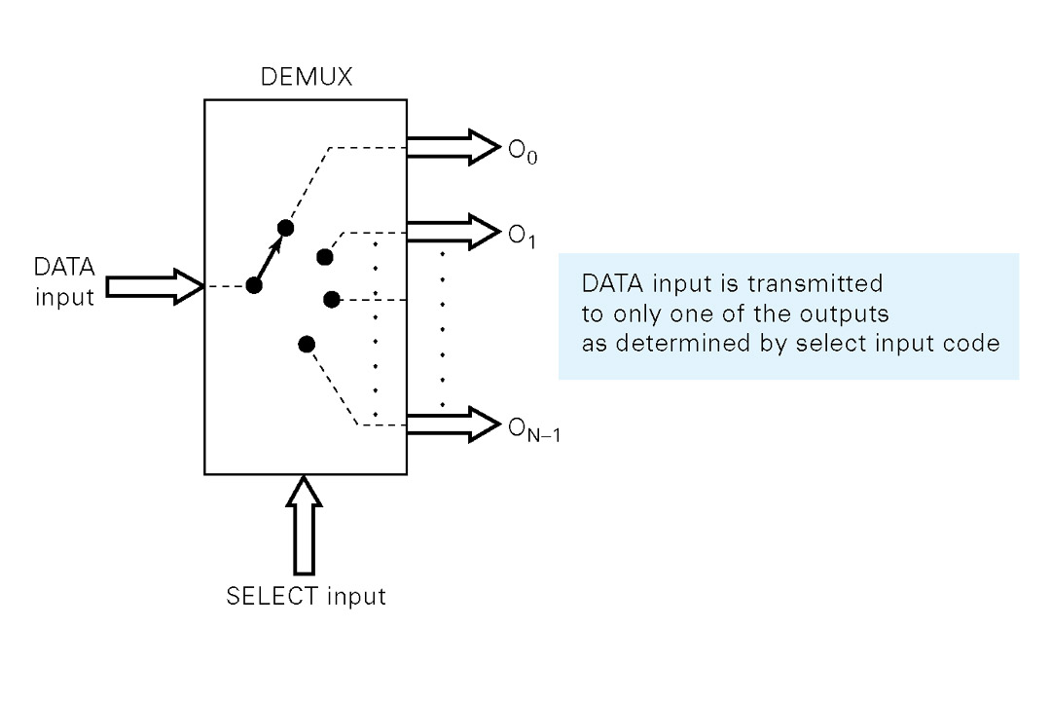
DEMUX : Functional Diagram
A demultiplexer switches (or routes) data from one input to 2^{N} outputs, where N is the number of select inputs.

Slide 6
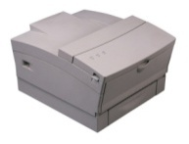
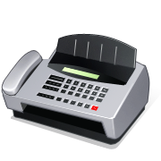



Typical Application of a DEMUX
Single Source
Selector
Multiple Destinations
B/W Laser
Printer
Fax
Machine
D0
D1
D2
D3
X
DEMUX
Color Inkjet
Printer
B | A | Selected Destination
0 | 0 | B/W Laser Printer
0 | 1 | Fax Machine
1 | 0 | Color Inkjet Printer
1 | 1 | Pen Plotter
Pen
Plotter
Notes:
This slide shows a typical application of a demultiplexer (in this case a 1-to-4 DEMUX). Ask students to share other common applications of DEMUXs.
Multiplexers & Demultiplexers
Digital Electronics™
Lesson 2.4 – Specific Combo Circuits & Misc Topics
Project Lead The Way, Inc.
Copyright 2009

Slide 7
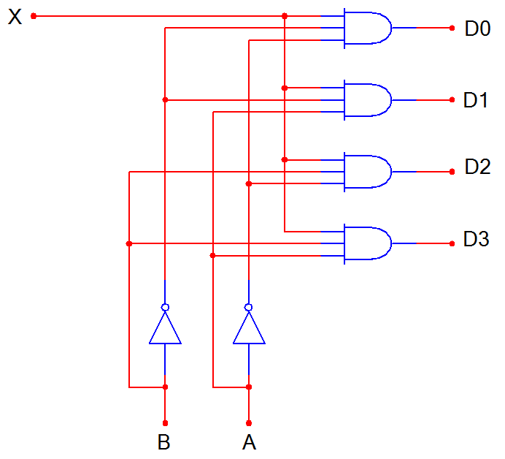
1-to-4 De-Multiplexer (DEMUX)
D0
D1
D2
D3
X
DEMUX
B A
B | A | D0 | D1 | D2 | D3
0 | 0 | X | 0 | 0 | 0
0 | 1 | 0 | X | 0 | 0
1 | 0 | 0 | 0 | X | 0
1 | 1 | 0 | 0 | 0 | X
Notes:
SSI logic diagram, block diagram, and truth table for a 1-to-4 De-MUX
Multiplexers & Demultiplexers
Digital Electronics™
Lesson 2.4 – Specific Combo Circuits & Misc Topics
Project Lead The Way, Inc.
Copyright 2009

Slide 8
1-to-4 De-Multiplexer Waveforms
X
S0
S1
D0
D1
D2
D3
Input
Data
Select
Line
Output
Data
Notes:
Waveform diagrams for a 1-to-4 De-MUX. The output signals (D0-D3) are colored RED to indicate when its is connected to the input X. Note: There is no significance to the value of the input data signal; it is intended solely to demonstrate that the select lines (A & B) will determine what output signal is connected to the input.
Multiplexers & Demultiplexers
Digital Electronics™
Lesson 2.4 – Specific Combo Circuits & Misc Topics
Project Lead The Way, Inc.
Copyright 2009

